Slide 1
Object Oriented Management
Taming Organizational chaos the way programmers do
Notes:
1
This presentation:
Traces the history of computer programming up to the invention of Object Oriented Programming.
Review some basic Oop concepts
Traces the history of business organizations, showing a parallel evolution that stops short of OOP
Speculated what business organization would look like if it had taken that last step that programming did.

Slide 2
1
A brief history of programming
Background used with permission
Notes:
2

Slide 3
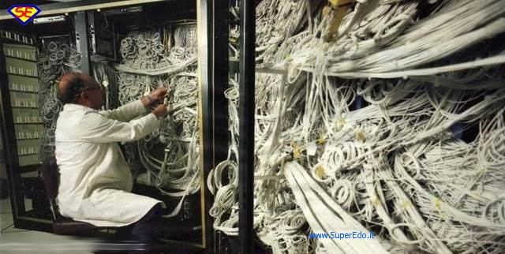
In the beginning, computers were programmed with
Used without permission
spaghetti hardware
Notes:
3
In the beginning analog computers had functional modules connected by wires

Slide 4
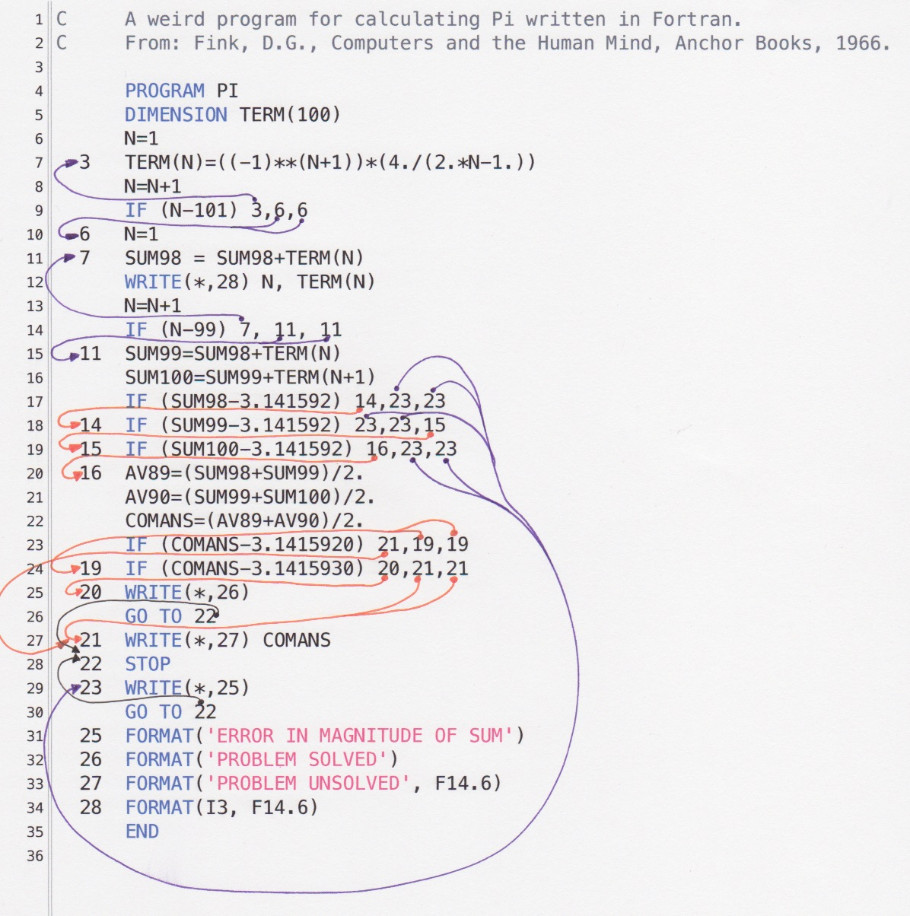
Evolving to: Spaghetti Software
Used without permission
From: The Craft of coding, https://craftofcoding.wordpress.com/2013/10/07/what-is-spaghetti-code/
Notes:
Early software did not look much different.

Slide 5
Spaghetti code
The complexity exceeds anyone’s ability to understand it.
The information that allowed someone to originally get it working is not stored with the program
Notes:
5

Slide 6
“Structured Programming”
Main
Init
Display
Command
Processing
On-Line
Clear
GUI
Bus. Logic
Driver
Driver
Look-up
Math Lib
This was the magic solution to spaghetti

Slide 7
Hierarchies
Encapsulation reduces complexity
Simple relationship between modules (A calls B with some data, and B returns data back to A)
Can be scaled infinity by nesting modules
Notes:
7

Slide 8
“Tramp Data”
Main
Init
Display
Command
Processing
On-Line
Clear
GUI
Bus. Logic
Driver
Driver
Look-up
Math Lib
Getting data from one place to another is messy.
Notes:
But the model is not realistic. If the Clear routine wants to clear something in the Math Library, it would have to pass flags all over the system. If you allow global data, the interfaces are simpler, but you lose the encapsulation.

Slide 9
Hierarchies
The model is too simple.
Diagram gives no clue to the data flow
Cohesion between modules is ignored
Hierarchies force unnatural data flow
Raises the data complexity at the top
Notes:
9

Slide 10
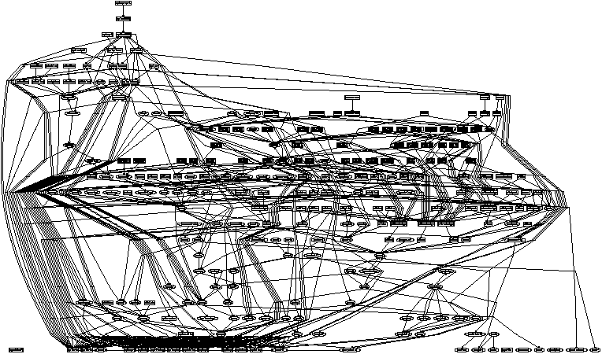
Real map of a real system
Used without permission
Notes:
10
This diagram was created by making a list of all subroutines and graphing which ones are called by which other ones. Some attempt has been made to order the subroutines to minimize line crossing.

Slide 11
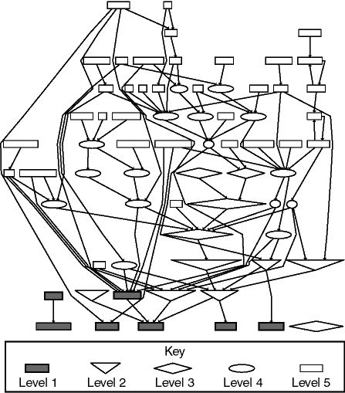
Minimizing interfaces is good
Here is the same system, with better clumping to minimize the interfaces between modules.
So what if it were the design goal?
Used without permission
Notes:
11
In this diagram of the same system, some subroutines were clumped together and the diagram only shows which clump was called. Assuming the number of subroutines in a module is small and the number of lines drawn is considerably less, the complexity of the model has been reduced (at the lost of some detail).
It is possible to Design systems to make the map look better, and that makes the code easier to understand.

Slide 12
Object Oriented Programming
Test Port
GUI
Business Functions
Abstraction
Security
Database
Backup
Network Engine
OOP: Today's solution to the problem

Slide 13
OOP
The model is as simple as the hierarchy (better than a detailed hierarchy)
Data flow dominates the design
Encapsulation reduces complexity
Notes:
13

Slide 14
2
Overview of OOP concepts
Notes:
14
Let's look at the common elements of OOP.

Slide 15
Encapsulation
A object has code and data to implement its functions, but they are not visible outside the object, because they encapsulated. This reduces the complexity by allowing us to see the top level without the details or see one modules’s details alone.
Score
Notes:
15
A chunk of code and data called "Score" is encapsulated so that you can understand its details without knowing the whole system, or understand the top level system without knowing its details.

Slide 16
Methods (Interfaces)
Score
The object has methods through which you can interact with it. (You don't need to have a single interface, like the hierarchy.)
Clear Score
Return Score
Increment Score
Decrement Score
Notes:
16
Only the modules's name and methods are visible on the outside.

Slide 17
Classes
Score
Interest
Clear Score
Return Score
Set principle
Increment Score
Decrement Score
Set interest Rate
Display Interest
Set Period
There are different kinds of objects, with different functions and different interfaces.
Notes:
17

Slide 18
Dynamic Dispatch
Tennis
Score
As an int
Clear Data
Return Data
As a string
Increment Data
Decrement Data
The methods are not bound to specific code, but can be dynamically assigned base on the type of data presented to the interface.
Notes:
18
Depending on how you access the Return Data method, it can either return an integer or a string. The code that implements this is not bound to the method, but dynamically assigned when the method is invoked.

Slide 19
Inheritance
Score
Bowling
Score
Report Status
Schedule Release
Report Status
Schedule Release
Feature Request
HR issues
Feature Request
HR issues
Support
Original Class New Class
New classes can be created with some of the properties of the original class and some differences
Notes:
19
You can design a general purpose Score class and use parts of it for the Bowling Score class. A Tennis Score object could also use the parts of Score that are useful.

Slide 20
Instances
Dave’s Bowling Score
Sue’s Bowling Score
Report Status
Schedule Release
Report Status
Schedule Release
Feature Request
HR issues
Feature Request
HR issues
Each object is an instance of a class of objects. The instances of a class have the same interfaces, but a more specific name.
Notes:
20

Slide 21
Subtype Polymorphism
Dart Score
Bowling Score
Report Status
Schedule Release
Report Status
Schedule Release
Feature Request
HR issues
Feature Request
HR issues
Support
Objects can share a common method with different objects, allowing either to be accessed from a third object.
Notes:
21

Slide 22
Open Recursion
Score
Clear Score
Return Score
Increment Score
Decrement Score
Score
Clear
Ret
Inc
Dec
Objects can execute copies of themselves.
Notes:
22

Slide 23
3
The evolution of human organizations
Notes:
23

Slide 24
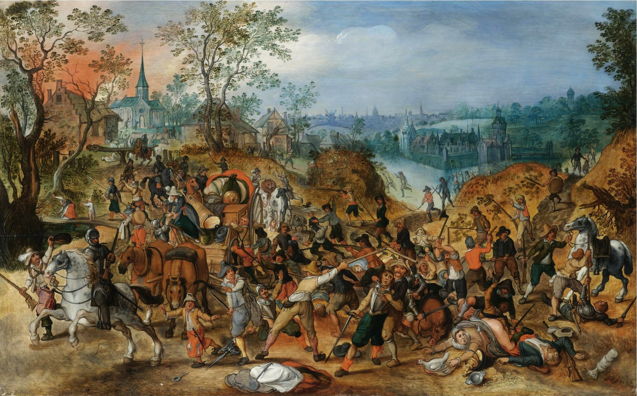
Used with permission
There must have been a time before Org charts.
Notes:
Presumably there was a time when there was no organization, and everyone acted independantly.

Slide 25
Or when drawing the char did not help.
Used without permission
Notes:
25
Of course, the hierarchy is just a model, in real life, the interaction between people is quite a bit more complicated.

Slide 26
CEO
Admin
Sales
Marketing
Finance
Opperations
Engineering
Supply
Inside sales
Channel
International
Eastern
Central
Western
Europe
Africa
China
Accounting
Dealer Credit
Eagan Plant
Roseville Plant
China
QA
Network
New Product
Support
Warehouse
Ordering
HR
The Hierarchy: the modern solution to organizing people.

Slide 27
The Hierarchy
Optimized for Command and Control
When people at the top see problems, they have the power to fix them.
Everyone has 1 and only 1 boss.
Limits to the Span of Control allow for adequate feedback to report problems
The model scales infinitely
Notes:
27

Slide 28
Is this the way you ask for more paper clips?
CEO
Admin
Sales
Marketing
Finance
Opperations
Engineering
Supply
Inside sales
Channel
International
Eastern
Central
Western
Europe
Africa
China
Accounting
Dealer Credit
Eagan Plant
Roseville Plant
China
QA
Network
New Product
Support
Warehouse
Ordering
HR
The model does not seem to match reality.
Notes:
Hey, this is just the same problem we have in programming! In real life, you boss is not the only connection to the organization. Many departments provide services to the rest of the company and they provide some kind of intervace for obtaining that service (web form, telephone number, a walk-up desk….)

Slide 29
The Hierarchy
Information flow through formal channels can be very long (and leaky)
When people at the bottom see problems…It is not their job.
The model ignores most of the real information flow.
Lack of redundancy leaves everyone as a weak link in the chain.
Managers have to be good at everything
Notes:
29

Slide 30
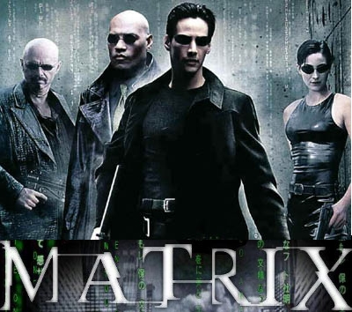
Then, in the 60’s these 4 people revolutionized corporate organization
Just kidding!
Notes:
30

Slide 31
Exec
The Matrix (idealized)
PMM
EMM
EM
EM
EM
PM
PM
PM
Notes:
31
Each element in the matrix has 2 interfaces, one for carrer management and one for managing projects.

Slide 32
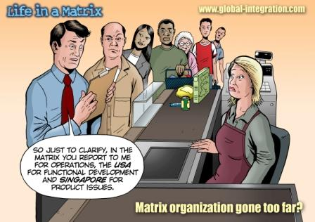
Common sense or resistance to change?
Used without permission
Notes:
32

Slide 33
The Matrix
Specialization allows different managers to master their tasks.
Chaos in one channel is less likely to compromise another channel
Notes:
33

Slide 34
The Matrix
Sometimes more than one boss is the same as no boss. (good and bad)
Is 2 the right number of interfaces?
Notes:
34

Slide 35
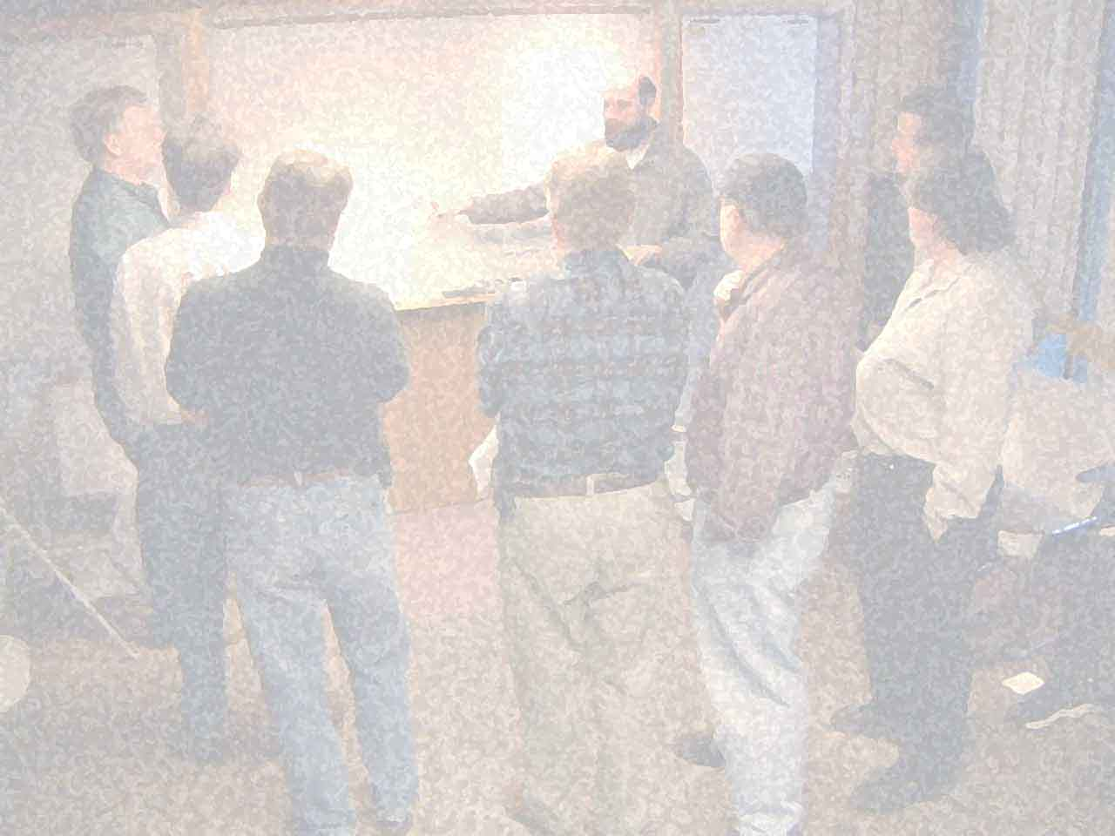
Then, in the 90’s these people revolutionized corporate organization again.
No fooling!
Used without permission
Notes:
35

Slide 36
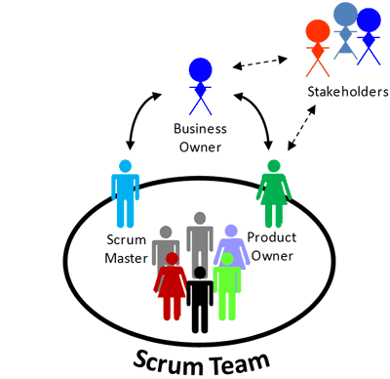
Ideal Scrum team
An SM and a PO are all a team needs interface to the rest of the company.
Used without permission
Notes:
36

Slide 37
Self-directed Team
Small teams have low complexity
Agile = responds quickly to feedback
Both specialization and generalized skills are encouraged.
Redundancy prevents bottle necks
Notes:
37

Slide 38
Self-Directed teams
Agile mostly describes just one team. How does the Agile team connect to the rest of the company?
Employees who don’t like their managers have tried to use Agile to justify self-managed teams. Organizations find that threatening.
Notes:
38

Slide 39
Real Scrum Teams
PO
SM
PM
Test
Boss
Dev
Boss
Admin
Team
Dev
Admin
But their aren’t just a Product Owner and a Scrum Master. We still cling to “everyone has a boss”, and the PMO may assign a project manager to the team. And or course, the Admins. are actually the interface to most the company.
Notes:
39
This "real" Scrum team looks more complicated than the hierarchy.

Slide 40
Scrum Teams
There does not seem to be a good model for connecting the team to the rest of the company.
Scrum defines the Product Owner and the Scrum Master role but does not give them the power to do the things teams in companies need to do.
Notes:
40

Slide 41
4
How can we apply the principals of OPP to give an organization of people the benefits programmers got from OOP?
Notes:
41

Slide 42
Encapsulation
The team has members, and the members have roles, responsibilities and tasks. But they are not visible outside the team, because they encapsulated.
Team
Notes:
42

Slide 43
Methods (Interfaces)
Team
The team has interfaces to the rest of the company. The interfaces are known to the company, but the implementation of them is defined by the team, and not public.
Report Status
Schedule Release
Feature Request
HR issues
Notes:
43

Slide 44
Human Methods
In a human system, a “method” could be:
A form or a spreadsheet template
A presentation at a meeting
A phone call or meeting with project coordinator.
An email with specified content.
…..
Notes:
44

Slide 45
Dynamic Dispatch
Team
The interfaces are not assigned to a person in the team charter, instead the team can shuffle roles at any time or assign a different person to an interface based on the nature of the request.
Report Status
Schedule Release
Feature Request
HR issues
Notes:
45
Dick can do the status reports wnen Paula is on vacation. Pete can develop June’s skills by letting her process the feature requests.

Slide 46
Trivial implementation
New ECC feature requests:
Email john.watson@company.com
New ECC feature requests:
Email ECC-features@company.com
Maybe John, retired. Maybe he is on vacation. Maybe he
handed the job to Pete, while John was focusing on the new architecture. Maybe Pete was just ready for some new responsibilities. The team owes the company an interface, not a job title.
Notes:
46

Slide 47
Classes
Development
Sales
Report Status
Schedule Release
Leads
Pricing Approval
Feature Request
HR issues
Revenue forecast
HR issues
There are different kinds of teams, with different functions and different interfaces.
Notes:
47

Slide 48
Instances
ICCC Development
New OS Development
Report Status
Schedule Release
Report Status
Schedule Release
Feature Request
HR issues
Feature Request
HR issues
Class Instance
Each real team is an instance of a team class. The instances of a class have the same interfaces, but a more specific name.
Notes:
48

Slide 49
Inheritance
ICCC Development
ICCC IG4 Development
Report Status
Schedule Release
Report Status
Schedule Release
Feature Request
HR issues
Feature Request
HR issues
Support
Original Class New Class
New classes can be created with some of the properties of the original class and some differences
Notes:
49

Slide 50
Subtype Polymorphism
ICCC Development
Infrastructure Development
Report Status
Schedule Release
Report Status
Schedule Release
Feature Request
HR issues
Feature Request
HR issues
Support
If the PMO requests a weekly status update from one development team, they get the same information from all teams, even though some teams are Agile and some are using waterfall
Notes:
50

Slide 51
Open Recursion
HR
Report Status
Update Benefits
Staffing Plan
HR issues
Even someone in HR can call HR to resolve issues.
Notes:
51

Slide 52
So what would an OOM implementation look like?
Notes:
52

Slide 53
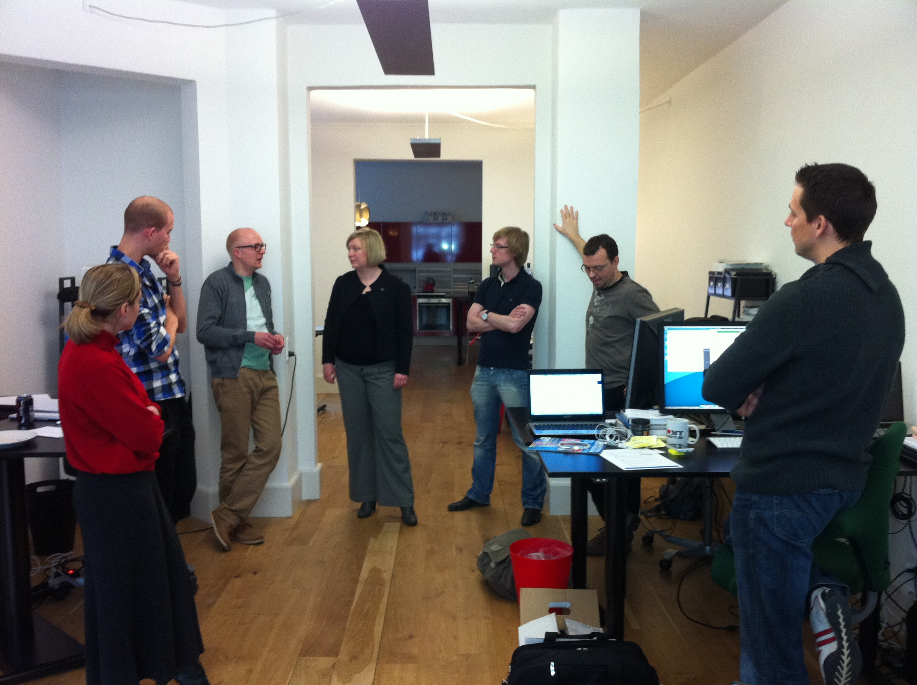
OOM Team
It is mostly the same Agile team
that you would see in Scrum,
except:
Used with permission
If there is a Scrum Master, she is part of the team and can fill any roles the team wishes. (If there were an global Scrum Master, there could be an interface for her.)
The customer is external to the team. A customer representative for the customer would be external. A Product Owner representing many customers might be internal.
Notes:
53

Slide 54
A sample “Org chart”
Exec
Council
Sales
PMO
Sponsor
HR
Team
IT
Notes:
54

Slide 55
Classical boss implementation
ICCC Development
Report Status
Schedule Release
HR issues
Feature Request
One team member does all the interfaces.
Notes:
55

Slide 56
Architect and Manager
ICCC Development
Report Status
Schedule Release
HR issues
Feature Request
The Architect steers the product. The manager does people tasks.
Notes:
56

Slide 57
PM and EM
ICCC Development
Report Status
Schedule Release
HR issues
Feature Request
Product Manager and Engineering Manger
Notes:
57

Slide 58
OOM Team
ICCC Development
Report Status
Schedule Release
Feature Request
HR issues
The assignments are not static. Tomorrow could be different.
Notes:
58

Slide 59
Sample PMO status Interface
Interface:
Send status report (on Friday)
Request for format change
Request Scope change
Notes:
59

Slide 60
Status report examples
On Thursday, Jim poles everyone and fills out the PMO’s web form.
Pete created a tool that copies all the necessary data out of Version One and builds a spreadsheet in PMO format.
The Friday morning meeting is longer, because a project coordinator brings a laptop and asks a lot of questions.
Notes:
60

Slide 61
Sample HR Interface
Interface:
Time card exceptions (jury duty…)
Employee requisition
Accomplishments and reviews
Notes:
61

Slide 62
Time card “method”
Like most companies now, everyone goes to some kind of central HR App. to report vacation time, jury duty…
If there are issues, the person managing the HR interface gets pinged.
Notes:
62

Slide 63
Requisition “method”
The person minding this interface is responsible for justifying new additions to the team.
The person may have a classical manager-like role, a senior team roll, or just be someone who does not have more critical work to do.
Notes:
63

Slide 64
Appraisal “method”
Each team member regularly records accomplishments in support of future raises and promotions.
Team members record comments on other employees (like eBay reputation).
At appraisal time, the team votes on a restricted number of merits to award.
HR crunches the numbers and gives raises
Notes:
64

Slide 65
OOM
Everyone does not need a boss. Most of the things people hate about bosses and appraisals could be eliminated.
A team could be not just self-organizing but almost autonomous.
The OOP model makes the information flow clearly visible.
Notes:
65

Slide 66
OOM
Without a boss, you are accountable to your team and your project. (and maybe your sponsor, who pays the bills). There are a lot more butts to kiss.
There is no safe place to hide, if your project is unsuccessful and no other projects wants you.
It is harder for companies to do top-down control.
Notes:
66

Slide 67
Disclosure:
The ideas presented are mine, and you have my permission to share and them.
The text and diagrams are mine, and I give you permission to use them as long as you put my name on them somewhere.
I stole a few colorful images from the web to make the presentation more interesting. I have included the copright notices, but have not obtained permission to use all the images. I can’t give you permission to use the images that I don’t have permission to use.

Slide 68
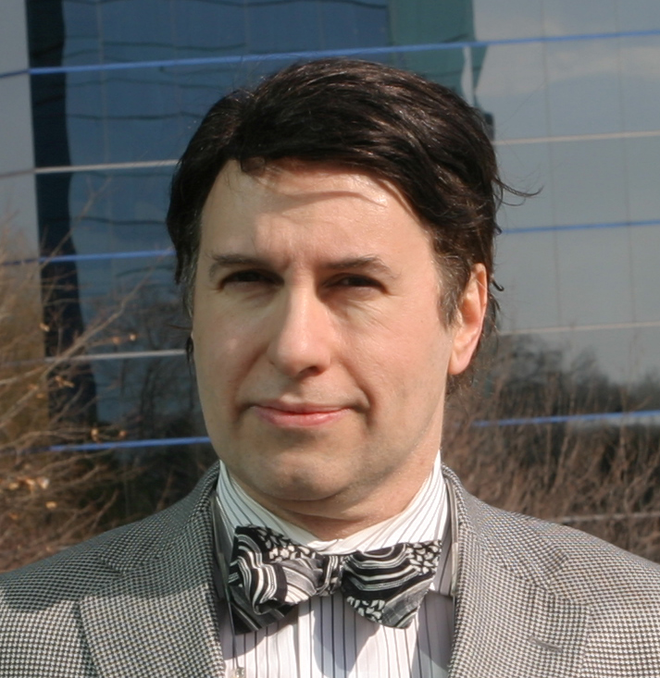
Help me develop this concept
Tomo Lennox:
Cell - 612-385-4326
Email - tomo@tomoLennox.com
Blog - tomoLennox.com
Notes:
68

